Slide 1
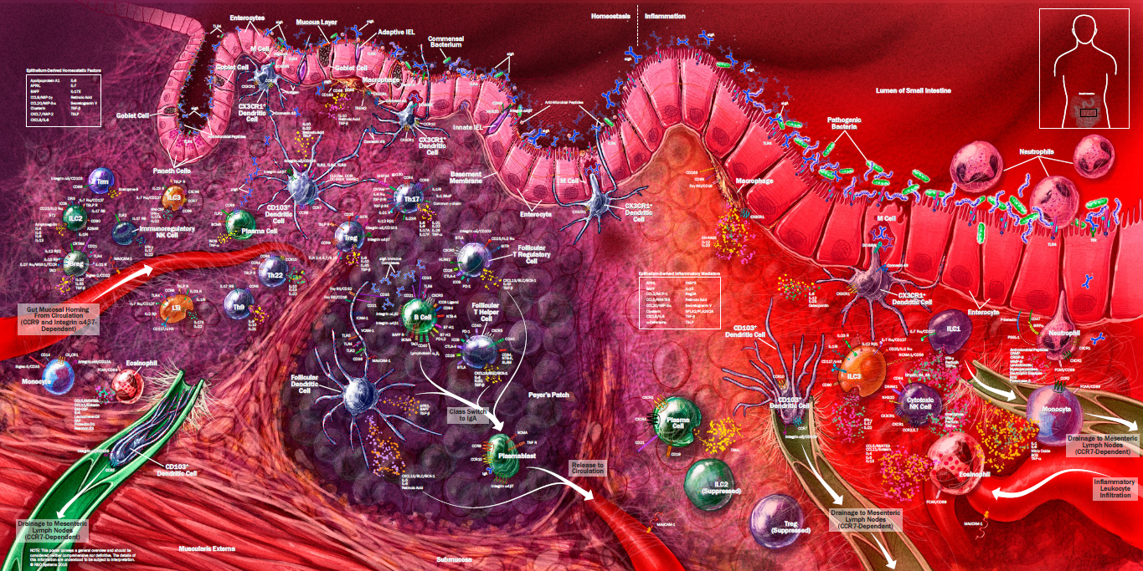
Bioinformatics Workshop – SPR2022
Overview of the Gut Microbiota
Daniel Bergey Ph.D. // Great Basin College

Slide 2
Brief Outline
The role of microbiota in health
Brief anatomy of gut mucosa
Microbiota-immune system connection
Maintenance of gut immune homeostasis
Inflammation and gut microbiota
Intro to microbiota-gut-brain axis

Slide 3
Microbiome: A community of micro-organisms living together in a particular habitat.
Every human body surface is exposed to the environment, and every body part with an opening to the environment, has a unique microbiome.
The human gastrointestinal tract harbors a unique microbiota community of about 10¹⁴ total microbes consisting mainly of bacteria, but also archaea, viruses, fungi, and protozoa. 1,500-2,000 different bacterial species.
Gut microbiota are highly variable among individuals, but certain common combinations of bacteria are found in healthy individuals.
Diet appears to be the primary factor in shaping the gut microbiota across during an individual’s lifetime.
Intestinal bacteria play a crucial role in maintaining immune and metabolic homeostasis, protection against pathogens, and neurological development
https://www.ncbi.nlm.nih.gov/pmc/articles/PMC5433529/

Slide 4
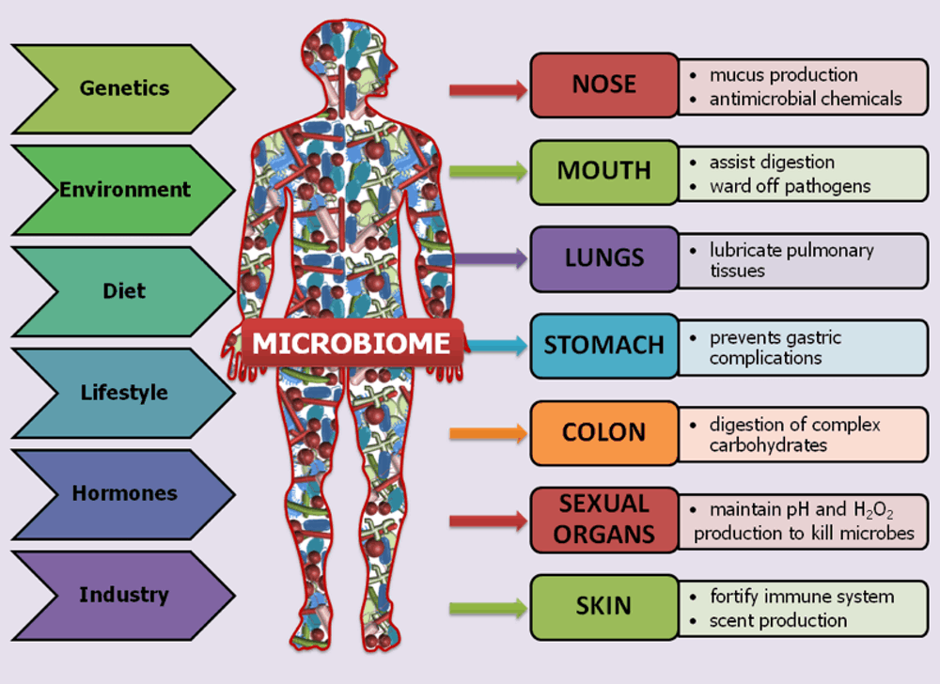
Various Microbiomes Living Within and On a Healthy Human

Slide 5
A Short Story...
→ One day some key body parts were arguing with each other about who was most important:
The brain said: “I’m the most important since I control everything”.
The heart said: “I’m the most important since my beating keeps the body going”.
The liver said: “I’m the most important since I play diverse roles in metabolism, excretion, detoxication, immune response, etc.”
Finally, the GUT said: “NO, I’m the most important! I digest, absorb, protect, defend, excrete, produce hormones, etc.”
EVERYONE LAUGHED UNCONTROLLABLY --- HA HA HA !!
The GUT got angry and shut down
Within a few days all the other body parts agreed... Gut IS Most Important !

Slide 6
“All disease begins in the gut.”
- Hippocrates 460 BC – 370 BC

Slide 7
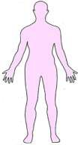
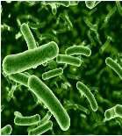
Gut Microbiota in Health - Symbiosis
Symbiotic relationship: Interaction between two different organisms living in close physical association, typically to the advantage of both.
For microbes:
Provides nutrients & shelter
Human (host)
Microbiome
For host:
Increases metabolic capacity of host. Helps breakdown complex plant carbohydrates, fiber. ~10% of the calories from diet.
Provides vitamins (B2, B12, K and folic acid)
Helps protect from colonization by pathogens (colonization resistance)

Slide 8
The GI Tract Presents Unique Challenges for the Mammalian Immune System
The GI tract (or GUT) must tolerate the presence of an estimated 100 trillion luminal microbes (microbiota),
and NOT respond inappropriately to these foreign squatters or their products, but still protect the intestinal mucosa from potentially harmful dietary antigens and invading pathogens.
The intestinal epithelium is a single layer of cells lining the gut that is essential for preserving gut homeostasis, and acts both as a physical barrier, and a coordinating hub for immune defense and crosstalk between bacteria and immune cells.

Slide 9
Metagenomics methods can currently map about 90% of microorganism genomes, which means these genomes can be prioritized for analysis.
Based on recent large-scale metagenomic studies of the microbiome from different body sites in individuals with both Westernized and non-Westernized lifestyles, the diversity of the human microbiome is estimated at 25 different phyla, an average of 2,000 genera and 5,000 species, and 316 million genes.
However, the diversity of a large fraction of the human microbiome remains unknown and unexplored.

Slide 10
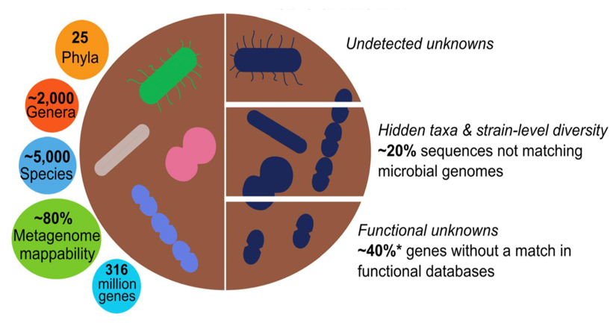
The Human Microbiome
What is known
What is unknown (?)

Slide 11
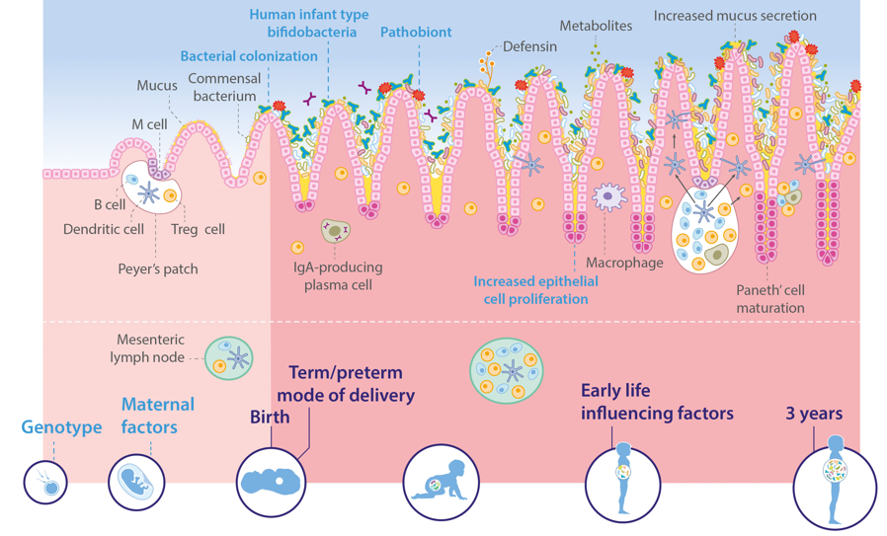
Normal Gut Microbiota & Immune Development
Early life nutrition is a critical factor in shaping the gut microbiota, and promoting appropriate brain development. Gaining better understanding of the microbiota-gut-brain relationship, and the role of nutrition in early neurological development is a very active area of current research.

Slide 12
Commensal Microbes Provide a Protective Function (barrier effect)
Compete and adhere to potential attachment sites on the brush border of intestinal epithelial.
Compete for available nutrients.
Produce antimicrobial compounds (defensins, bacteriocins).
→ Collectively these factors (and the mucous layer) help prevent attachment and entry of pathogenic bacteria into intestinal epithelial cells

Slide 13
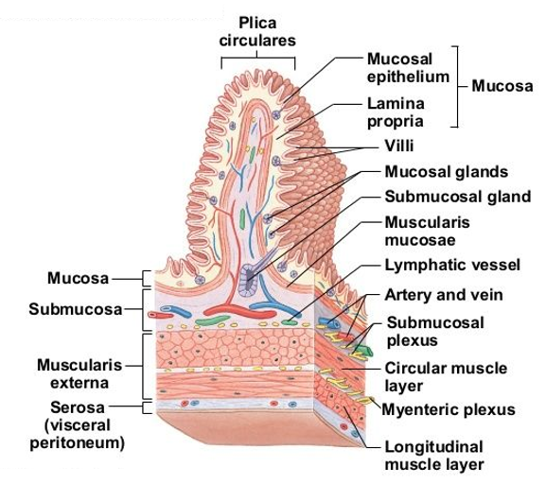
Microanatomy of Gut Wall
Intestinal mucosa provides a physiological barrier for most microbes, including both commensal bacteria and invading pathogens.
The lamina propria layer contains various immune cells including DCs, Macs, IgA-producing plasma cells, B cells and various T cells.
Note the extensive innervation of the gut (referred to as “the second brain”)

Slide 14
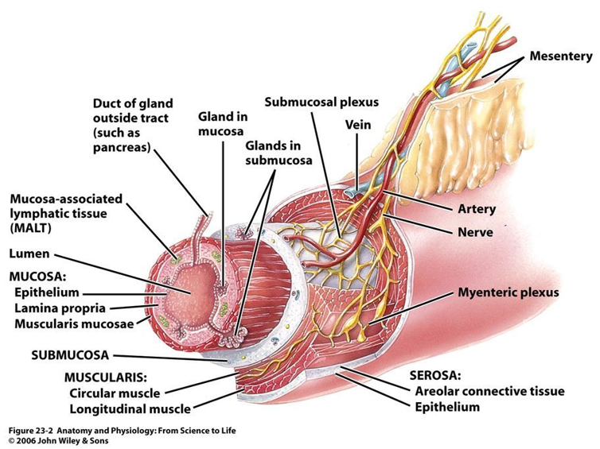
Enteric Nervous System

Slide 15
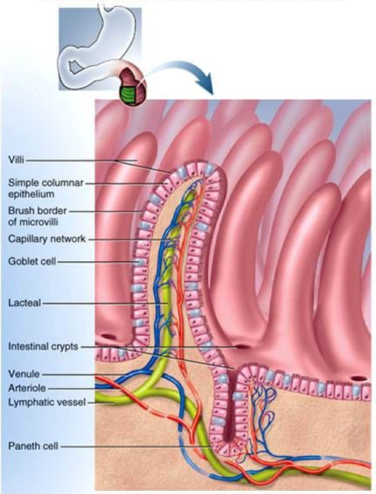
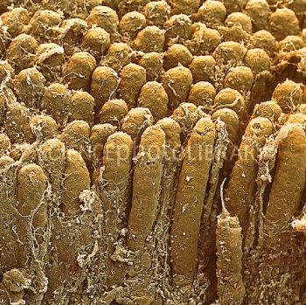
Intestinal Villi and Lymph/Blood Circulation
Gut lumen

Slide 16
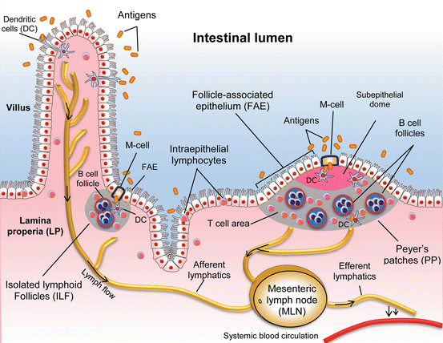
GALT: Gut-Associated Lymphoid Tissue
GALT is the largest lymphatic organ in the human body and contains about ~75% of the body’s total lymphocytes.
GALT is exposed to more antigens than any other part of the body (e.g., commensal bacteria, dietary gut antigens, and invasive pathogens).
Intestinal Lumen
Paneth cells located in intestinal crypts
https://link.springer.com/chapter/10.1007/978-3-319-28609-9_14

Slide 17
Major Components of GALT
Peyer’s patches (PP) are a collection of lymphoid nodules distributed in the mucosa and submucosa of the intestine. Contain various immune cells (B and T cells, macrophages, DCs).
Follicle-associated epithelium (FAE) is a single layer of epithelial cells separating lymphoid areas of PP from the intestinal lumen.
M cells are embedded in the epithelium (FAE) just above Peyer’s Patches; the “gateway” for transport of luminal antigens to PP.
Paneth cells secrete antimicrobial proteins into gut lumen.
Dendritic cells (DC) sample gut lumen contents; key immune sensors and regulators (e.g., mediate IgA production).
IgA antibodies are secreted into gut lumen.
Mesenteric lymph nodes (MLN) collect lymph from intestinal mucosa.

Slide 18
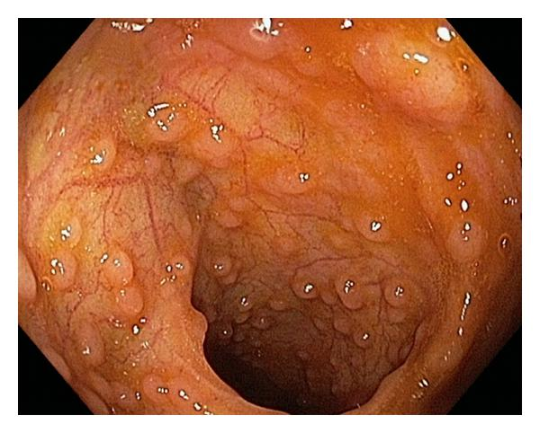
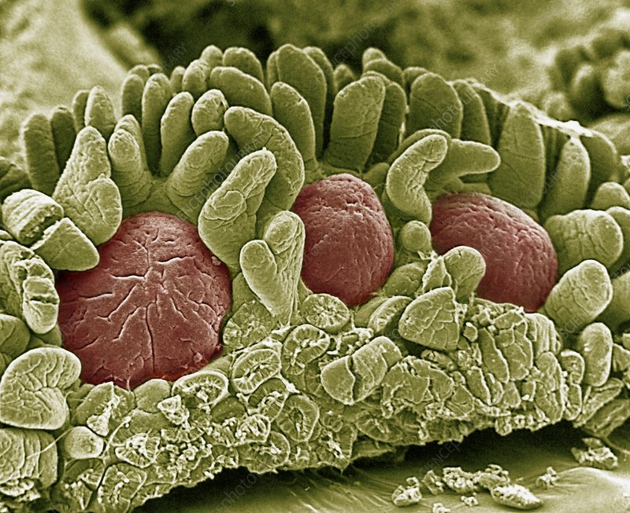
Peyer’s Patches (“Intestinal Tonsils”)
Peyer’s patches (PP) in the distal ileum (20-yr old man).
Scanning EM of Peyer’s patches (colorized)

Slide 19
Role of DCs and IgA in Gut Immune Surveillance & Tolerance
Dendritic cells (DC) continuously sample luminal antigens and promote tolerance to microbiota by inducing IgA synthesis in B cells, and mediating differentiation of Treg cells. Functional effectiveness of intestinal DCs is strongly influenced by the gut microenvironment, including the presence of commensal bacterial metabolites, epithelial cell-derived factors, and dietary products.
DCs interact with luminal antigens that cross M cells of Peyer’s patches (PP), and from isolated lymphoid follicles (ILF) that are transported into the lamina propria (LP).
DCs also sample antigens directly from the lumen via trans-epithelial projections, and then either (a) present antigens to local lymphocytes, OR (b) migrate to mesenteric lymph nodes (MLN) for lymphocyte priming, resulting in subsequent systemic immune activation.

Slide 20
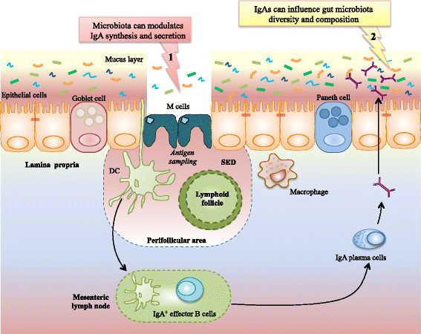
Role of DCs and IgA in Gut Immune Surveillance & Tolerance
https://www.researchgate.net/publication/294284585_Policing_of_gut_microbiota_by_the_adaptive_immune_system

Slide 21
Role of IgA in Gut Immunity
Under homeostatic conditions, immunoglobulin A (IgA) is the major immunoglobulin isotype in the intestinal mucosa (and all mucosa). 2-3 grams of IgA is produced and secreted into the gut lumen every day
Gut microbes trapped by DCs stimulate the production of IgA in Peyer’s patches (or the mesenteric lymph nodes).
Subsequent IgA binding to microbes, or their products, inhibits bacterial translocation across the gut epithelium, and neutralizes toxins at the intestinal mucosal surface.

Slide 22
T-regulatory (Treg) Cells and Tolerance to Commensal Microbes
“Germ-free” (GF) animal models (e.g., mice) provided the first formal proof that the microbiota was required for the induction and maintenance of intestinal Treg cells.
Mice, and humans, treated with antibiotics show depletion in resident microbiota, correlating with a drastic reduction in the intestinal population of Treg cells.
In addition to known immune-related roles, recent studies show that intestinal Treg cells also exert important non-immune functions in the gut, such as promoting local tissue repair and preserving the integrity of the intestinal epithelial barrier.
https://www.frontiersin.org/articles/10.3389/fimmu.2020.600973/full

Slide 23
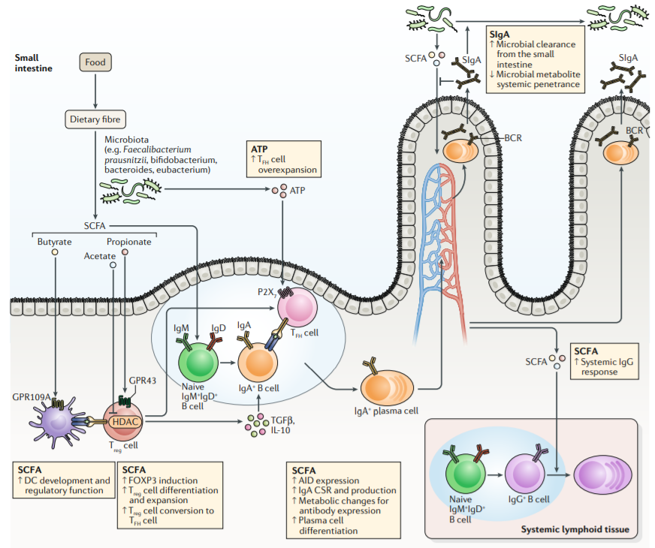
Commensal Gut Microbes Generate Short Chain Fatty Acids (SCFAs) that Induce Treg Cell Differentiation
Small intestine lumen
Treg cell

Slide 24
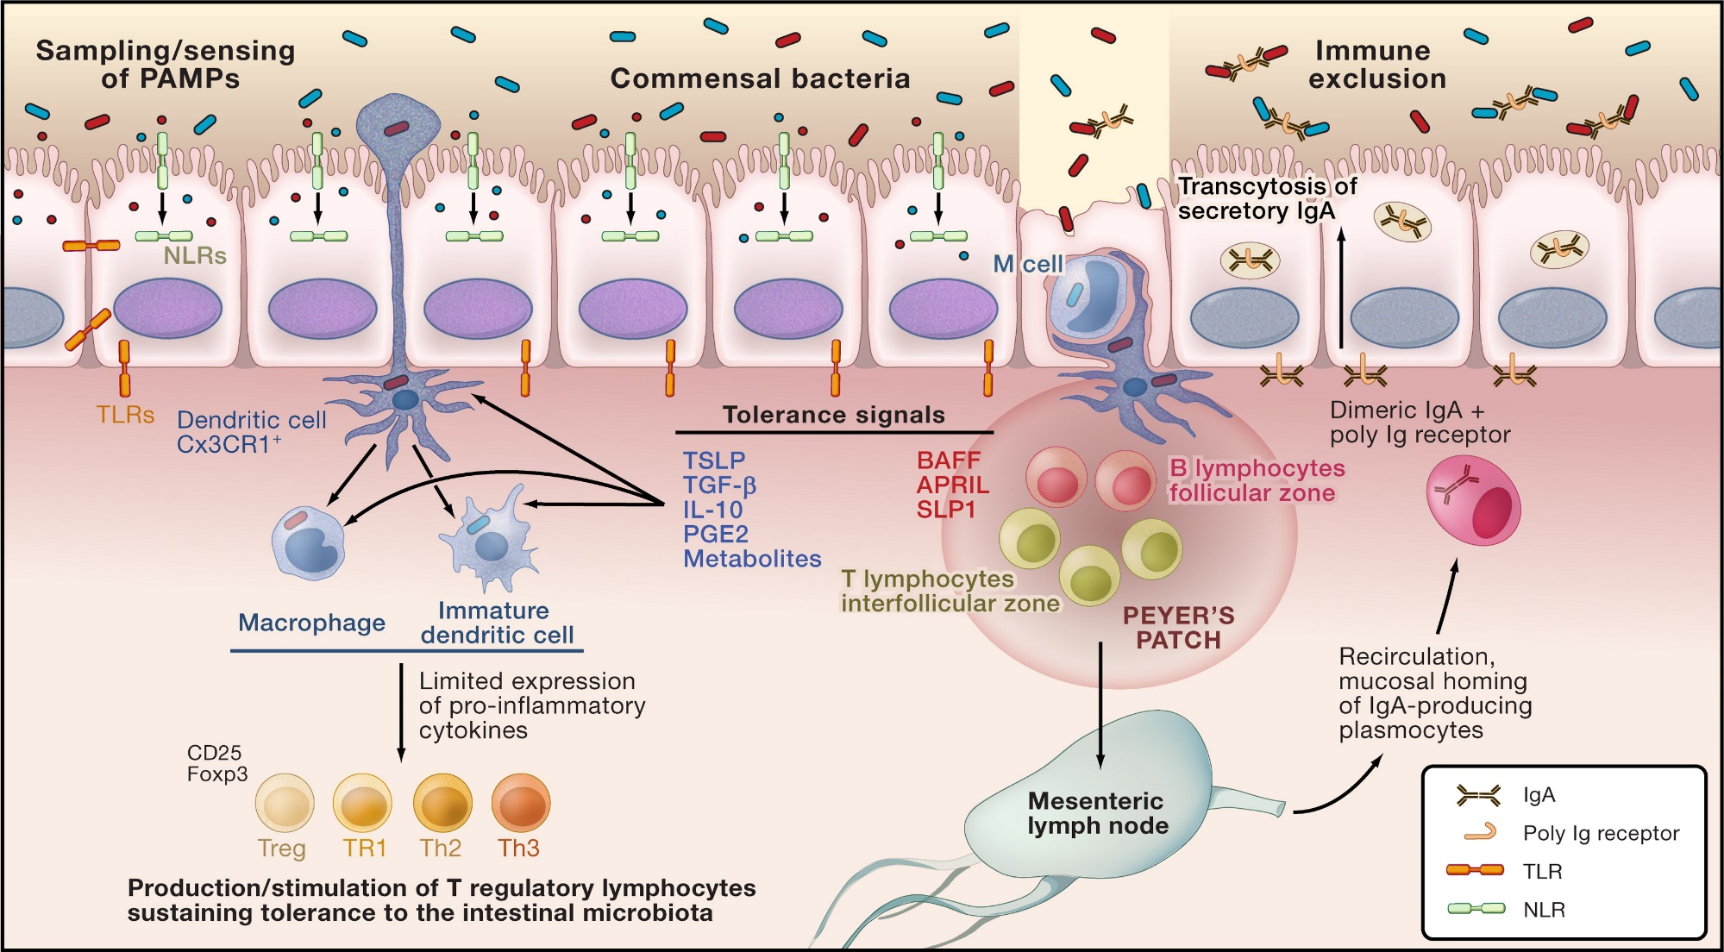
Innate & Adaptive Immune Responses in Gut Surveillance & Tolerance to Microbiota
Potential tissue-damaging, inappropriate T cell responses can be inhibited by immunosuppressive cytokines and regulatory T cells (T regs).

Slide 25
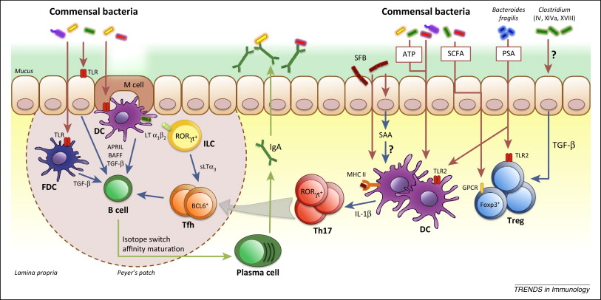
Role of Microbiota and Immune Response in Maintaining Gut Homeostasis
Microbiota stimulation leads to B cell switch to IgA, induction of Treg cells, and T cell differentiation to Th17
SCFA (short chain fatty acids); PSA (polysaccharide A); SFB: segmented filamentous bacteria
Commensal bacteria
Commensal bacteria
Lamina propria layer of gut
Peyer’s patch

Slide 26
Key Immune Signals and Receptors
Cytokines: Signal molecules that regulate hematopoiesis and host responses to infection, immune responses, inflammation, and trauma. Some ae pro-inflammatory, and others reduce inflammation and promote healing.
PRRs (pattern recognition receptors): Innate system component consisting of large family of receptors in host cells that recognize evolutionarily conserved molecular structures found on general classes pathogens (e.g., TLR).
PAMPs (pathogen-associated molecular patterns): Pathogen-derived signal molecules (e.g., LPS, peptidoglycan) recognized by PRRs that elicit immune response.
DAMPs (danger/damage-associated molecular patterns): Host-derived signal molecules that initiate immunes responses. Can also promote pathological inflammatory responses.

Slide 27
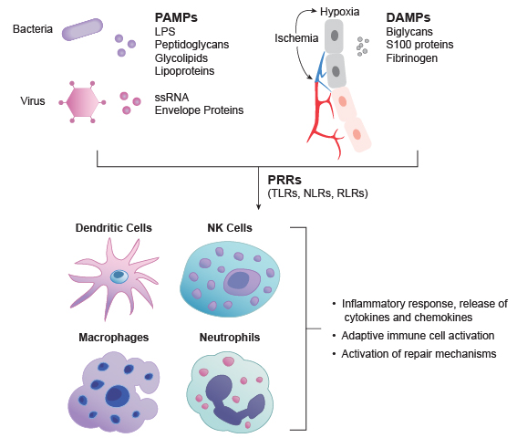
PAMPs & DAMPs Interact w/Host PRRs to Activate Innate Immunity & Inflammatory Responses
Microbe-derived PAMPs drive inflammation in response to infections.
DAMPs: derived from host cells including tumor cells, dead/dying cells (e.g., sterile inflammation) or substances released from cells in response to stress, such as hypoxia.

Slide 28
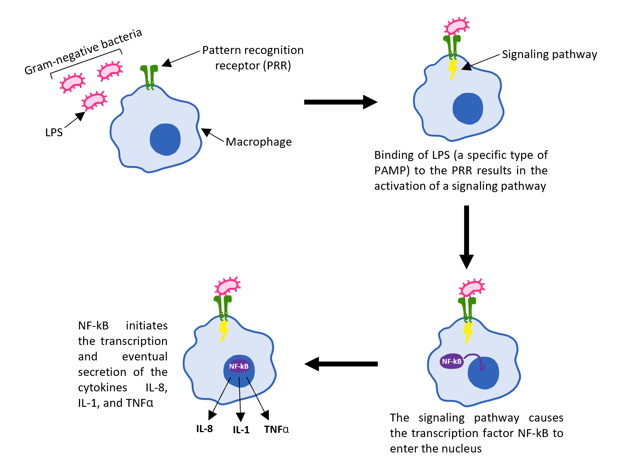
PAMP-PRR Interaction Triggers Immune Cell Activation and Cytokine Release
(PAMP)
Immune cell differentiation

Slide 29
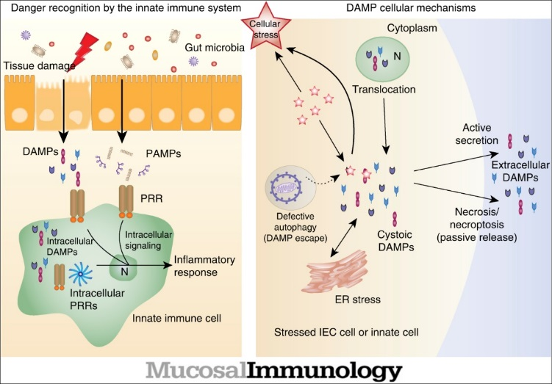
Gut Mucosal DAMPs & Inflammation
Gut microbiome

Slide 30
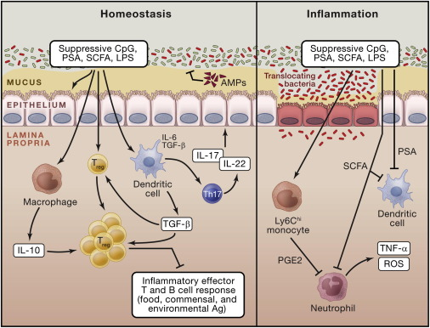
Gut Microbiota in Homeostasis and Inflammation
Left panel: Commensal microbes promote induction of Treg cells via direct sensing of microbial products or metabolites by T cells or DCs. Other commensal microbes promote the induction of Th17 cells that can regulate function and homeostasis of gut epithelial cells.
Right panel: Commensal-derived metabolites can have local and systemic effects on inflammatory cells. For example: SCFAs inhibit neutrophil activation. Upon entrance into tissue, inflammatory monocytes can respond to microbial products by producing immune signal molecules (e.g., PGE₂) that limit neutrophil activation and associated tissue damage.
SCFA: Short chain fatty acids
AMP: Antimicrobial proteins
PSA: Polysaccharide A
LPS: Lipopolysaccharide
https://www.cell.com/fulltext/S0092-8674(14)00345-6v

Slide 31
Gut Microbiota in Homeostasis & Inflammation
SCFA: Short chain fatty acids
AMP: Antimicrobial proteins
PSA: Polysaccharide A
LPS: Lipopolysaccharide

Slide 32
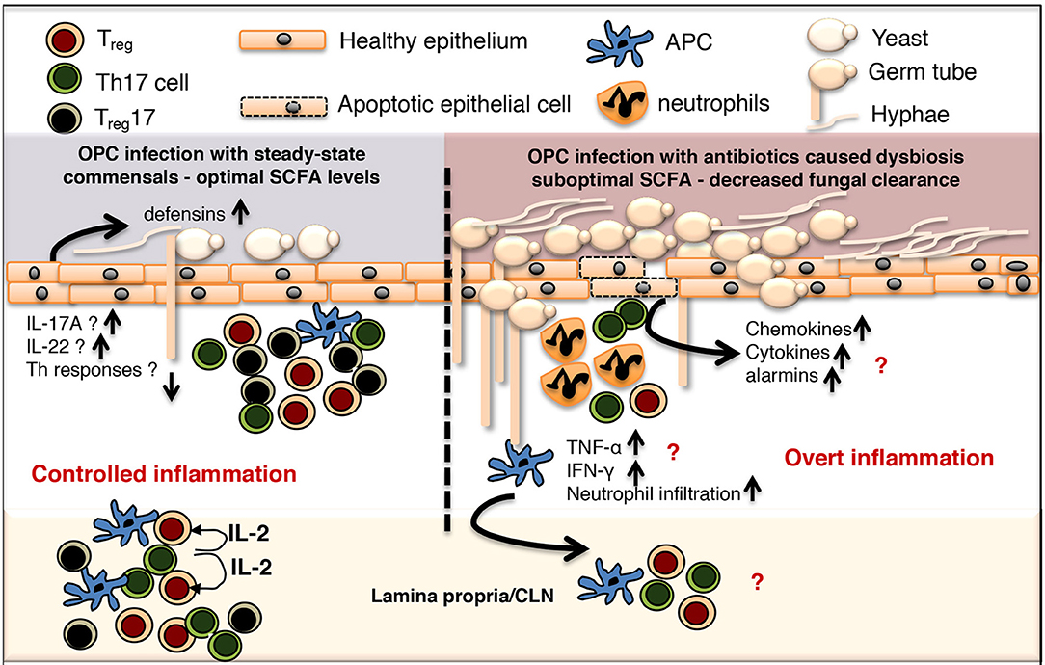
SCFAs contribute to immune homeostasis in mucosa, BUT... excessive & sub-optimal levels of SCFAs are often associated with inflammation and cancer.
→ Example below: Response to oralpharyngeal candidiasis (OPC)
Overt inflammation
Controlled inflammation

Slide 33
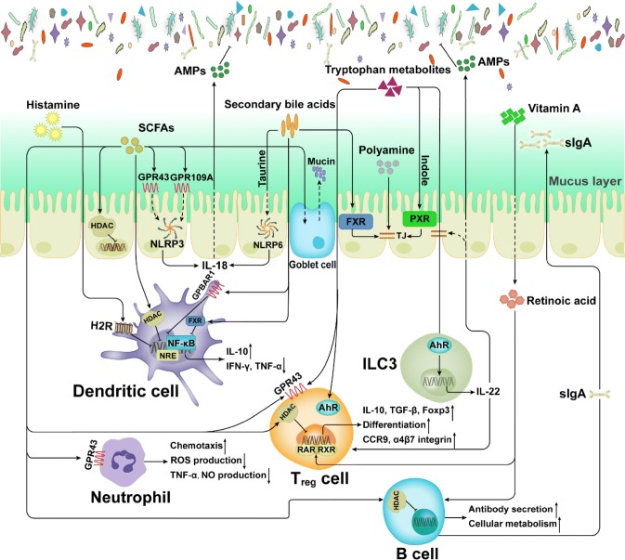
Metabolites Derived from Microbiota or Host Mediate Host-Microbiota Interactions
SCFAs (short chain fatty acids)
AMPs (antimicrobial peptides)
HADC (histone deacetylase)
TJ (tight junction)
AhR (aryl hydrocarbon receptor)
FXR (farnesoid X receptor)
PXR (pregnane X receptor)
ILC3 (group 3 innate lymphoid cell)
Gut lumen & microbiota

Slide 34
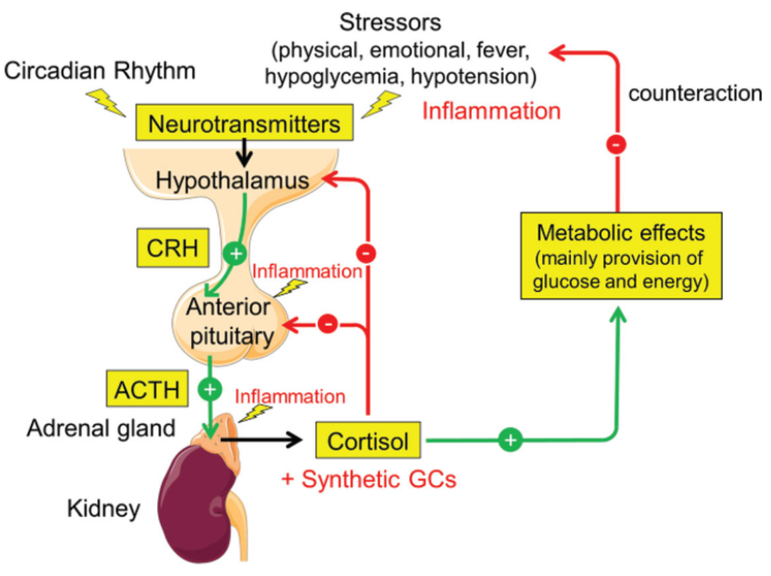
Inflammation and the HPA Axis (HPA: hypothalamic-pituitary-adrenal axis)
Activation of the HPA axis promotes inflammatory responses in both the brain and peripheral tissues.
Depressed individuals have elevated levels of cortisol and pro-inflammatory cytokines, such as C-reactive protein (CRP) in their blood.
HPA axis hyperactivity also promotes development of a range of cardiometabolic, inflammatory, endocrine, and neural disorders.
https://journals.lww.com/cmj/fulltext/2020/04050/gut_hormones_in_microbiota_gut_brain_cross_talk.11.aspx

Slide 35
The HPA Axis (Summary)
Various “stressors” (physical, emotional, fever, hypoglycemia, or hypotension) trigger release of corticotropin-releasing hormone (CRH) from the hypothalamus.
CRH induces release of adrenocorticotropic hormone (ACTH) from the anterior pituitary, which in turn stimulates the adrenal gland to produce and release cortisol.
Cortisol initiates diverse metabolic effects (e.g., mobilization of fuel molecules), which attempt to counteract the stressor. Cortisol also directly suppresses immune system.
Regulation of the HPA axis is mediated by cortisol-dependent negative feedback on the hypothalamus and anterior pituitary. Synthetic glucocorticoids (GCs) also cause negative feedback regulation, but this can also lead to adrenal suppression.

Slide 36
Is Cortisol Pro-inflammatory or Anti-inflammatory ?
Virtually all cells in the body have cortisol receptors (glucocorticoid receptor; GR)
Cortisol suppresses inflammation by inhibiting several pro-inflammatory cytokines produced by some immune cells
Chronic stress leads to overproduction of cortisol. And over time, immune cells may become desensitized to cortisol and express fewer cortisol receptors. In this way, chronic stress can lead to chronic inflammation because the normal anti-inflammatory effect of cortisol is diminished.

Slide 37
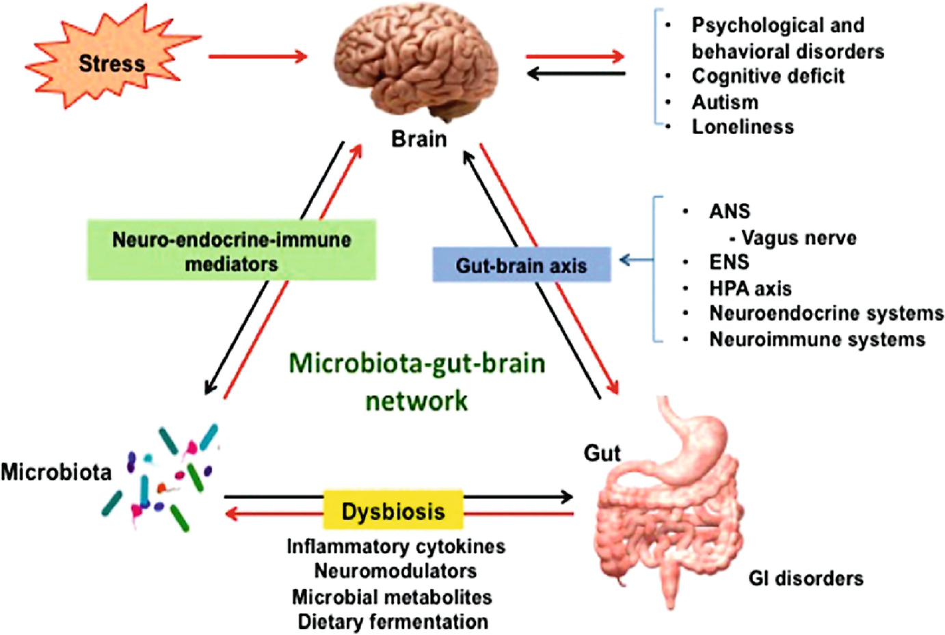
Microbiota-Gut-Brain Axis
Stress increases norepinephrine levels, which can stimulate the proliferation of enteric pathogens. Additionally, the ANS is another pathway through which the CNS influences enteric microbiota. Parasympathetic and vagal outputs to the intestine and stomach are altered after acute stress stimulation.

Slide 38
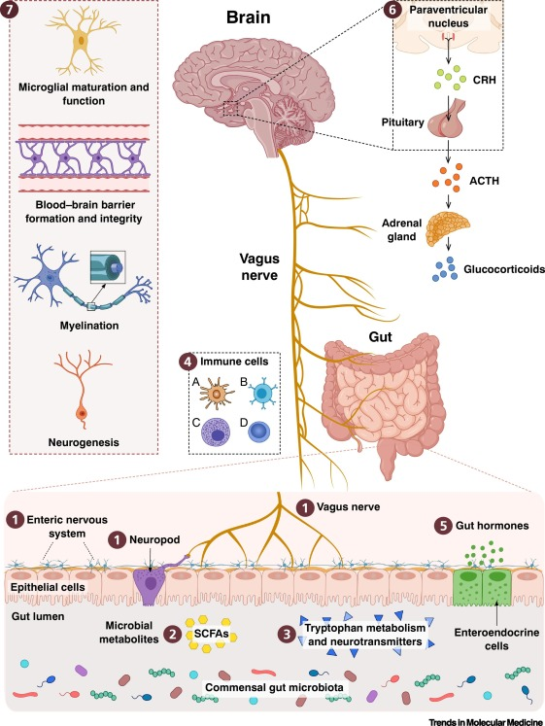
Microbiota-Gut-Brain Axis
Recent research demonstrate as an important role for gut microbiota in the regulation of brain development and behavior.
Host pattern-recognition receptors (PRRs) that recognize conserved microbe surface molecules (peptidoglycans, etc.) have emerged as key regulators of gut microbiota–brain interactions.
HPA axis
(cortisol)
https://www.sciencedirect.com/science/article/abs/pii/S1471491420301325
commensal gut microbes

Slide 39
Microbiota-Gut-Brain Axis
Studies on “germ-free” (GF) animals demonstrate that microbiota influence stress reactivity and stress/anxiety-like behavior, AND regulate the set point for HPA activity (sensitive !). GF animals exhibit lower overall anxiety but, when stressed, exhibit an increased stress response with highly elevated levels of ACTH and cortisol (and CRP)
Both neural (vagus) and hormonal (HPA axis) lines of communication combine to enable brain to influence activities of diverse intestinal immune cells including epithelial cells, enteric neurons, smooth muscle cells, and enterochromaffin cells (produce epinephrine & norepinephrine). These cells, in turn, are under the influence of the gut microbiota, which impacts the brain–gut axis not only locally with intestinal cells, but also by directly influencing neuroendocrine and metabolic systems.

Slide 40
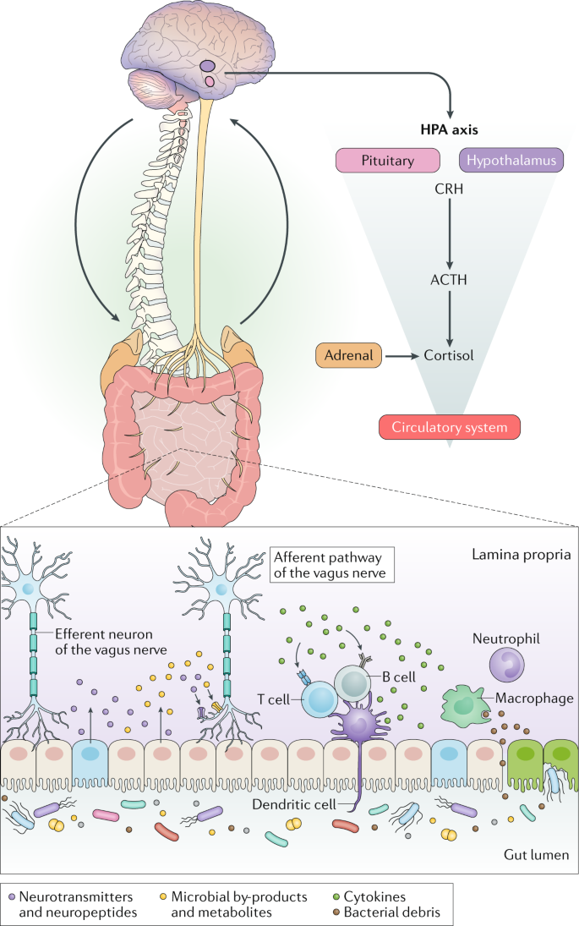
Microbiota-Gut-Brain Axis
Two-way communication between the gut microbiota and the central nervous system (CNS) is mediated by several direct and indirect pathways of the gut–brain axis.
Microbiota affects the expression of genes involved in HPA axis regulation and local metabolism of glucocorticoids in chronic psychosocial stress (COVID lockdowns ?)

Slide 41
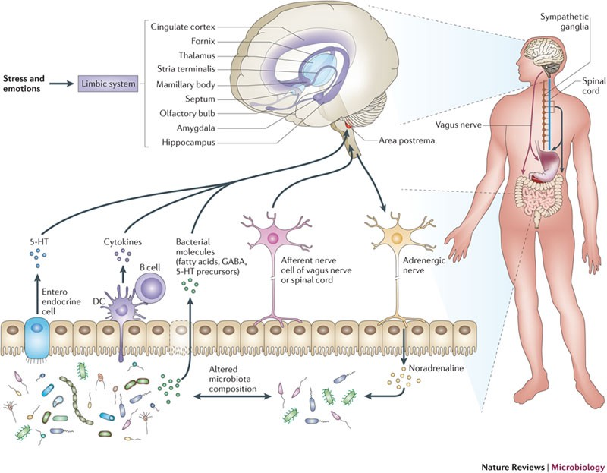
Microbiota-Gut-Brain Axis
https://medium.com/@The_Plastics/mind-altering-microorganisms-713790e070c5

Slide 42
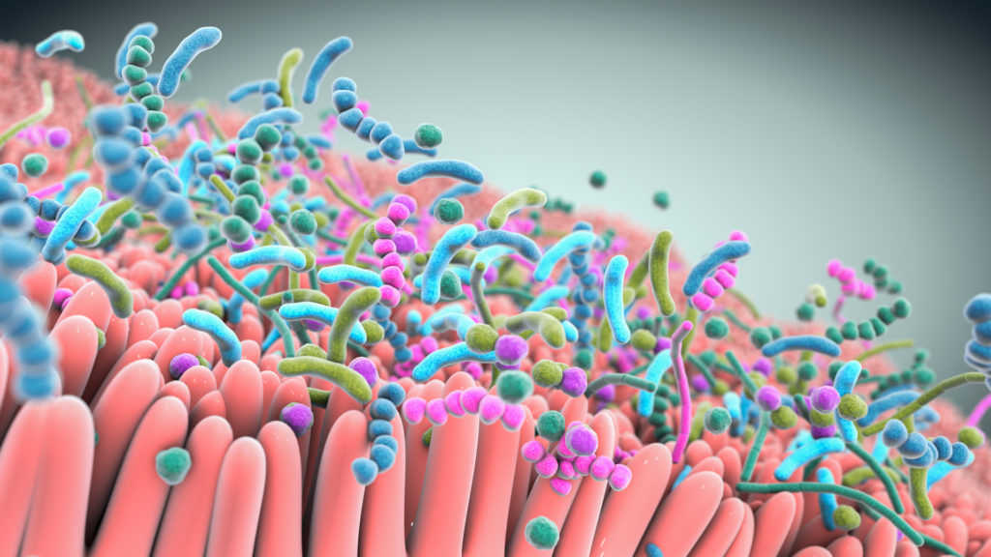
THANK YOU !
INBRE (IDeA Network of Biomedical Research Excellence)
Nevada Bioinformatics Center (NBC) at UNR
Great Basin College
Dr. Juli Petereit (Director NCB)
Drs. Tin Nguyen, Lucas Bishop, and Hans Vasquez-Gross

